Slide 1

TASK-CENTRIC AUTONOMOUS MACHINE LEARNING MODEL APPROACH
MINOR PROJECT
BATCH NO : 21PA12, IV-I, CSE-A
Dr.A.L.Sreenivasulu
( Professor)
B.Siri 21P61A0531
B.Manasa 21P61A0532
B.Adithya 21P61A0533
TEAM MEMBERS

Slide 2
CONTENTS
Abstract with Keywords
⁠Introduction
Literature Survey
⁠⁠Problem statement
⁠Objectives
Software and Hardware requirements
Proposed Methodology
Design
Modules
Implementation
Results
References

Slide 3
ABSTRACT
Researchers are advancing artificial intelligence (AI) by integrating computing, big data, and machine learning (ML) algorithms. AI is widely applied across industries, with efforts to standardize ML tools for non-experts. Key focuses include autonomous ML, ontology construction for concept standardization, and task-based workflows. A proposed task ontology-based ML model uses UML activities to group processes and automatically extends ML models via transformation rules based on common structures and relationships.
Keywords: Artificial Intelligence Technology, Task Ontology, Autonomous Machine Learning,
Ontology Construction.

Slide 4
INTRODUCTION
Autonomous Machine Learning (AutoML) systems aim to simplify and enhance the development of machine learning models through automation. This project, "Autonomous Machine Learning Modeling using a Task Ontology," explores how task ontology can guide the automatic selection, configuration, and evaluation of machine learning models. By formalizing tasks and mapping them to suitable algorithms, the system enhances efficiency and reduces the manual effort required for model development. The focus lies on optimizing the model lifecycle, including preprocessing, feature selection, and hyperparameter tuning, while ensuring adaptability across diverse application domains.

Slide 5
LITERATURE SURVEY
REFERENCE NAME | AUTHOR | PROS | CONS
Autonomous Machine Learning Modeling using a Task Ontology | Kyoung Soon Hwang, Ki Sun Park, Sang-Hyun Lee , Kwang-Il Kim, Keon Myung Lee | Provides a structured ontology Easily extendable and refined Supports mapping to other domain ontologies | Limited ability to reduce unnecessary tasks. Progressive refinement required. Challenges in improving model accuracy
Ontology-Based Fault Tree Analysis Algorithms in a Fuzzy Environment for Autonomous Ships | BekirSahin,Anis,Yazidi,Dumitri | Advanced analysis through ontology-based approach Applicability and reliability | Complexity in implementation Limited focus on specific scenarios.
Machines Learn Better with Better Data Ontology: Lessons from Philosophy of Induction and Machine Learning Practice | Dan Li | Uses UML diagrams effectively. Supports knowledge reuse. | Complex to implement. Requires familiarity with UML
Using ontology to guide reinforcement learning agents in unseen situations | Saeedeh,Ghanadbashi,Fatemeh,Golpayegani | Efficient and modifiable. Easy experimentation and deployment. | Limited to CNNs. May lag behind newer frameworks.

Slide 6
LITERATURE SURVEY
REFERENCE NAME | AUTHOR | PROS | CONS
Models for Representing Task Ontologies | Aline Freitas Martins, Ricardo de Almeida Falbo | Reusable Knowledge Structured Representation using UML | Limited Maturity in Domain Ontologies Complexity in Integration
Task ontology: Ontology for building conceptual problem solving models | Mitsuru Ikeda, Kazuhisa Seta, Riichiro Mizoguchi, Osamu Kakusho | Improved Task Decomposition Flexibility and Adaptability | Complexity in Ontology Creation Limited Generalization
Expose: An Ontology for Data Mining Experiments | Joaquin Vanschoren, Larisa Soldatova | Efficient Reuse of Knowledge Structured Task Decomposition | Complex Implementation Limited Scope
TensorFlow: A system for large-scale machine learning | Zhifeng Chen, Michael Isard, Benoit Steiner, Vijay Vasudeva | Scalable and Flexible | Requires familiarity with ML ad complex to implement

Slide 7
LITERATURE SURVEY
REFERENCE NAME | AUTHOR | PROS | CONS
A translation approach to portable ontology specifications | Gruber, T. R. | Facilitates Knowledge Sharing | Potential generalisation
Cafee : Convolutional Architecture for Fast Feature Embedding | Mitsuru Ikeda, Kazuhisa Seta, Riichiro Mizoguchi, Osamu Kakusho | Efficient and modifiable Easy Experimentation and deployment | Limited to CNNs May lag behind newer frameworks.
Ontology-Based Data Access in Statoil | Evgeny Kharlamov, Dag Hovland, Martin Georg Skjæveland, Dimitris Bilidas | Scalable for large datasets Enhances data integration | Complex implementation Requires domain expertise
Ontology Development Methodology: A Systematic Review and Case Study | Y. Alfaifi | Comprehensive review of methodologies Applicable to diverse domains | Theoretical focus Limited practical validation

Slide 8
PROBLEM STATEMENT
Developing machine learning models is time-consuming and resource-intensive, requiring significant domain expertise to define problem-solving steps, select algorithms, and configure workflows. This project addresses these challenges by proposing a task ontology-based modeling method that classifies problem-solving steps into tasks, automates model generation using UML activities and transformation rules, and optimizes resource reuse to enhance the efficiency and adaptability of autonomous machine learning systems.

Slide 9
OBJECTIVES
The objective of this project is to develop an advanced autonomous machine learning system that systematically defines, organizes, and structures the problem-solving process as tasks using a task ontology framework. By leveraging UML activity groupings, the system automates and extends model generation through transformation rules based on common elements and relationships, enabling more efficient workflow automation. Additionally, the project focuses on enhancing adaptability and scalability by reusing existing resources and incorporating relearning mechanisms to generate new knowledge. This approach aims to streamline the development process, reduce manual intervention, and improve the flexibility and efficiency of machine learning applications across diverse domains.

Slide 10
SOFTWARE AND HARDWARE REQUIREMENTS
Software Requirements:
Programming Language: Python, HTML, CSS
Libraries: Scikit-learn, TensorFlow, OpenCV
Data Manipulation: Pandas, NumPy
Data Visualization: Matplotlib, Seaborn
Development Environment: PyCharm, or VSCode
Database: SQL or NoSQL (optional for large datasets)
Web framework: Django
Hardware Requirements:
Processor: Multi-core CPU (Intel i5/i7 or AMD Ryzen)
Memory: 8 GB RAM (16 GB recommended)
Storage: 256 GB SSD or larger, 500 MB File size
Network: Internet access for libraries and tools

Slide 11
PROPOSED METHODOLOGY
Project Goals:
Develop an autonomous machine learning model using task ontology to automate workflows and enhance efficiency across diverse applications.
Develop Task Ontology:
Create a structured framework to classify and organize problem-solving steps into tasks for precise mapping to algorithms
Apply Transformation Rules:
Implement rules to convert task ontologies into executable workflows based on common elements and relationships.
Model Generation:
Automatically generate machine learning models by automating preprocessing, feature selection, and hyperparameter optimization.
Integration and Execution:
Integrate and deploy the generated models into real-world environments, ensuring adaptability and scalability.

Slide 12
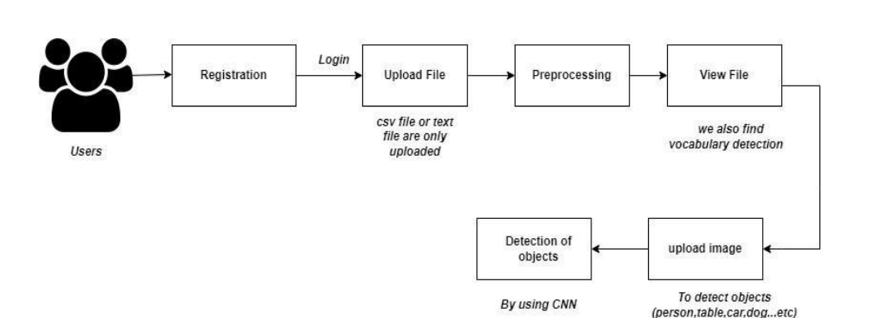
DESIGN
SYSTEM ARCHITECTURE

Slide 13
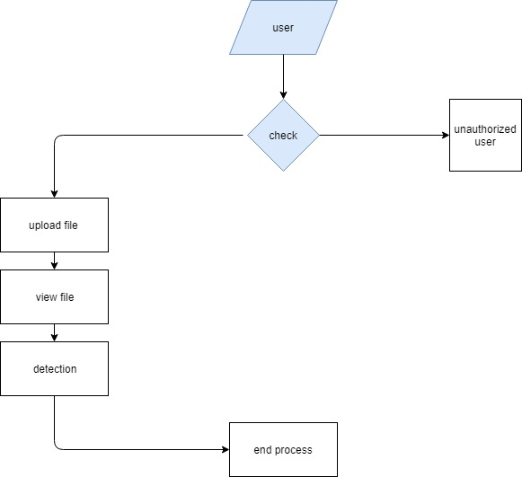
DATA FLOW DIAGRAM

Slide 14
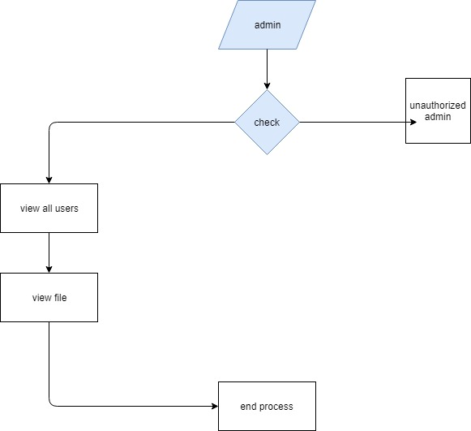

Slide 15
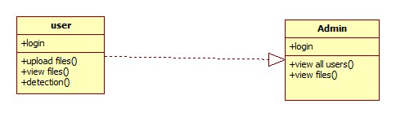
UML DIAGRAMS
CLASS DIAGRAM

Slide 16
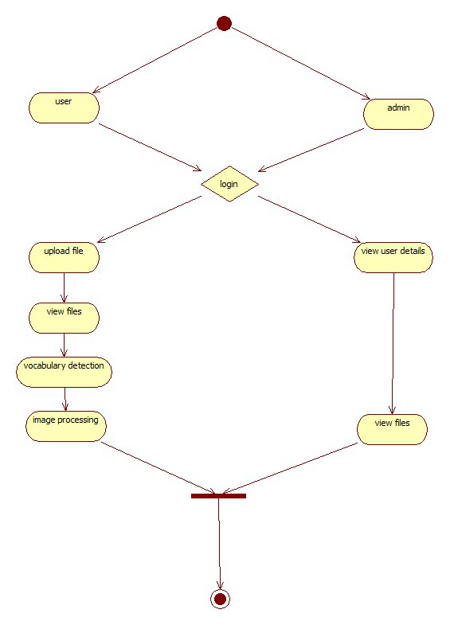
ACTIVITY DIAGRAM

Slide 17
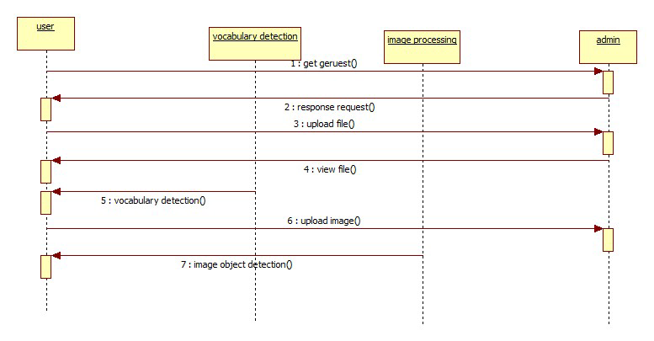
SEQUENCE DIAGRAM

Slide 18
MODULES
Data Collection Module: The Data Collection Module gathers raw data from various sources, including text data (e.g., documents, articles), image data (e.g., photographs, scans), and other relevant datasets. It ensures that the data is diverse, balanced, and representative of the tasks the system aims to solve. Tools: pandas, NumPy, BeautifulSoup (for web scraping), OpenCV. Technologies: Data extraction, Dataset creation, Data preprocessing, Data cleaning.
Preprocessing Module: The Preprocessing Module cleans and prepares the collected data for machine learning tasks. It handles missing values, removes noise from text or images, normalizes or standardizes numerical features, and splits the data into training and testing sets. It also prepares text data using tokenization, stop-word removal, and lemmatization, while image data may be resized, normalized, and augmented Tools: pandas, scikit-learn, NLTK (Natural Language Toolkit), OpenCV Technologies: Data cleaning, Text preprocessing, Image preprocessing, Data transformation, Data splitting.

Slide 19
Feature Engineering Module: The Feature Engineering Module creates new features from the raw data to enhance the performance of the machine learning model. For text, it may generate features like TF-IDF or word embeddings, while for images, it may extract features such as edges, corners, and textures. This module also explores feature correlations to identify key variables. Tools: pandas, scikit-learn, NumPy, OpenCV Technologies: Feature extraction, Exploratory Data Analysis (EDA), Feature selection, Text vectorization (TF-IDF, word2vec, etc.), Image feature extraction.
Model Training Module: The Model Training Module selects and trains various machine learning algorithms based on the problem at hand (text analysis, image detection, etc.). It includes algorithms like Logistic Regression, Decision Trees, Random Forest, SVM, Convolutional Neural Networks (CNN) for image detection, and natural language processing (NLP) models for text. The module applies hyperparameter tuning to optimize model performance. Tools: scikit-learn, xgboost, TensorFlow, Keras, PyTorch Technologies: Machine learning, Deep learning, Model selection, Hyperparameter tuning, Model training

Slide 20
Model Evaluation Module: The Model Evaluation Module assesses the trained models' performance using various metrics like accuracy, precision, recall, F1-score, and ROC-AUC for classification tasks. It compares the performance of different models and selects the best one based on the evaluation results. For image detection, additional metrics like IoU (Intersection over Union) and mAP (mean Average Precision) may be used. Tools: scikit-learn, matplotlib Technologies: Model evaluation, Performance metrics, Model comparison, Visualization.
Task Ontology Integration Module : The Task Ontology Integration Module uses a task ontology to structure the problem-solving process, mapping different tasks (such as text classification, image detection, etc.) to suitable algorithms. It helps automate task mapping, ensures workflow consistency, and enhances the model’s adaptability to different domains. Tools: Python, Ontology libraries (e.g., rdflib, OWL API) Technologies: Task ontology, Task classification, Workflow automation, Knowledge representation.

Slide 21
Model Deployment & Monitoring Module: The Deployment & Monitoring Module integrates the selected model into a real-time system for text analysis, image detection, or other tasks. It deploys the model through a web interface or API and monitors its performance over time, automatically retraining or updating the model with new data to maintain accuracy and relevance. Tools: Flask, Streamlit, FastAPI, Docker Technologies: Web deployment, API integration, Continuous monitoring, Model retraining, Model versioning.
Relearning & Knowledge Reuse Module: The Relearning & Knowledge Reuse Module enables the system to leverage prior models and workflows to enhance its performance. By integrating feedback loops and relearning mechanisms, this module ensures that the system adapts to new data, improving its predictions and outcomes over time Tools: scikit-learn, TensorFlow, PyTorch Technologies: Relearning, Knowledge reuse, Continuous learning, Incremental model improvement.

Slide 22
IMPLEMENTATION
1. Initialize Project and Import Libraries:
Used Django for web development and integrated NLTK for natural language processing tasks.
Employed OpenCV for image analysis and TensorFlow for machine learning model building.
2. Data Acquisition and Preparation :
Tokenized and cleaned text data using NLTK for better analysis and model input.
Preprocessed image data (resizing, normalization) using OpenCV for consistency in model training.
3. Dynamic Text Analysis Using Task Ontology :
Implemented AMWR for dynamic text analysis, enabling continuous adaptation to new data.
Used task ontology to automate task mapping and improve model efficiency.

Slide 23
4. Distributed Learning with Federated Learning Framework :
Simulated client nodes for decentralized training, ensuring privacy in data processing.
Aggregated updates from clients using a central server, forming a global model.
5. Ontology-Based Health Risk Assessment:
Integrated YOLO for real-time object detection in medical images to identify health concerns.
Used AMWR to analyze data trends for accurate health risk predictions.
6. User Interface and Results Display :
Developed a Django-based user interface to display real-time analysis results.
Enabled users to interact with the system and view insights on text analysis and image detection.

Slide 24
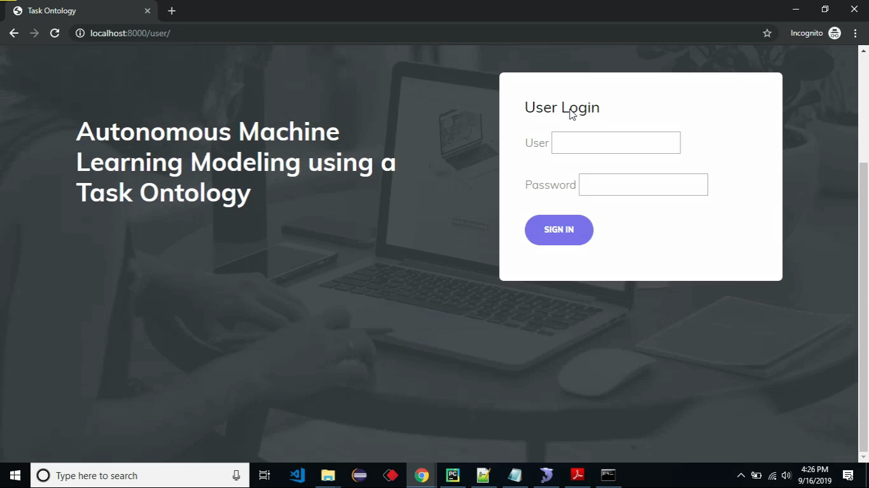
RESULTS
The image displays a login interface designed for a web-based platform, allowing users to securely access the system by entering their username and password. This interface is a gateway for both regular users and administrators to manage and utilize the platform's features. It provides a simple and intuitive design to ensure ease of use while maintaining secure authentication. The login functionality is essential for safe guarding user data and controlling access to various tools and resources within the system.

Slide 25
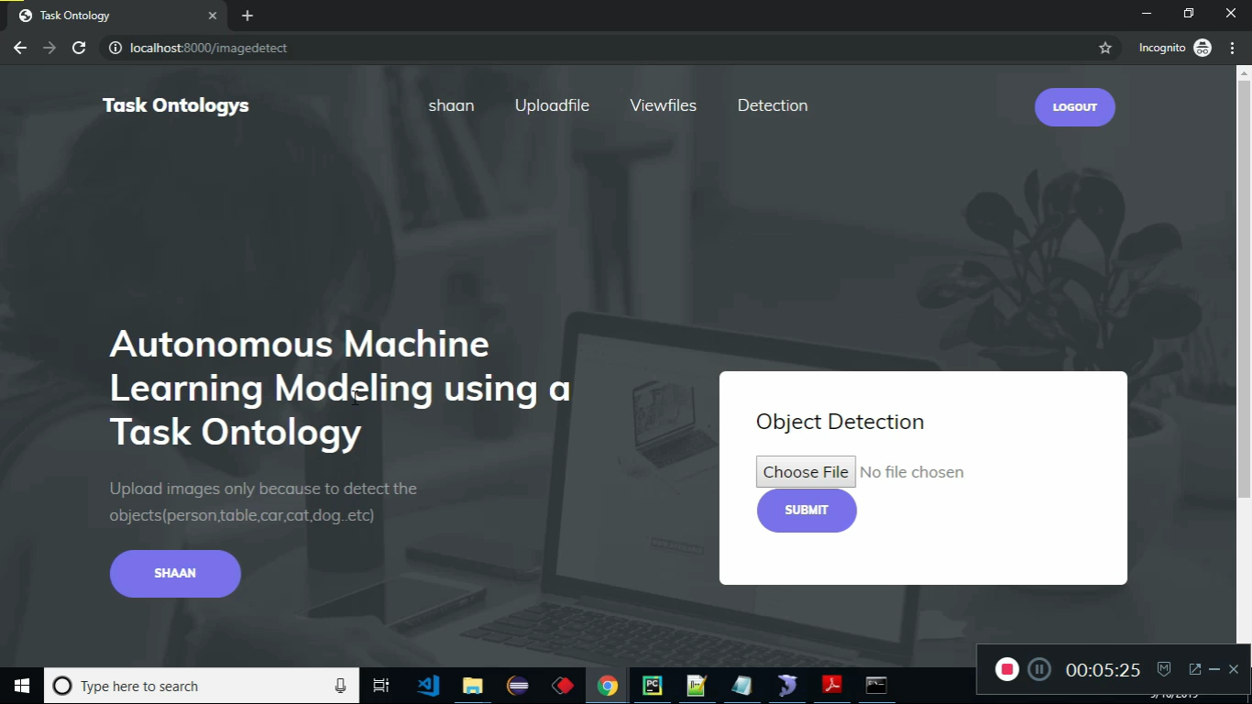
The image shows a user interface that enables users to upload images for object detection purposes. Through this interface, users can choose and submit an image file to analyze and identify various objects or items present in the uploaded image. The platform's design ensures accessibility and provides users with an efficient way to interact with the object detection feature, making it suitable for different use cases such as identifying objects in a scene or categorizing items

Slide 26
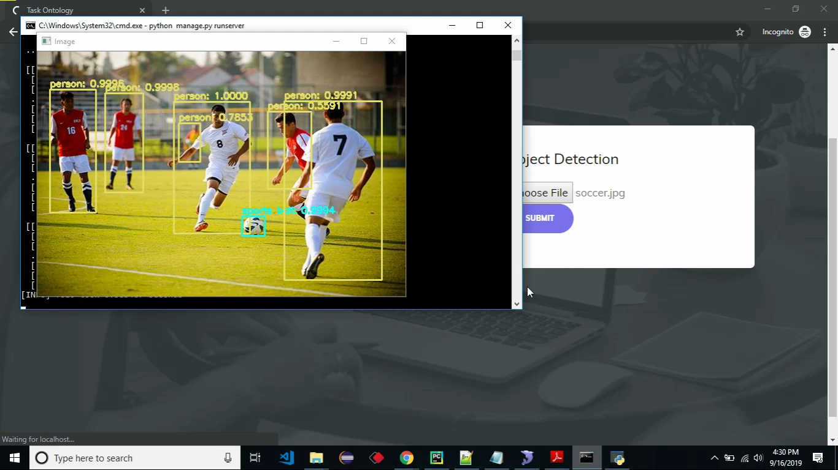
The image illustrates the results of the object detection process, where the system has successfully identified and labeled individual objects in the uploaded image. In this example, the system detects and highlights players and elements within a sports scenario, providing detailed annotations with confidence scores. This demonstrates the platform's ability to process visual data and deliver meaningful insights by recognizing and classifying objects accurately.

Slide 27
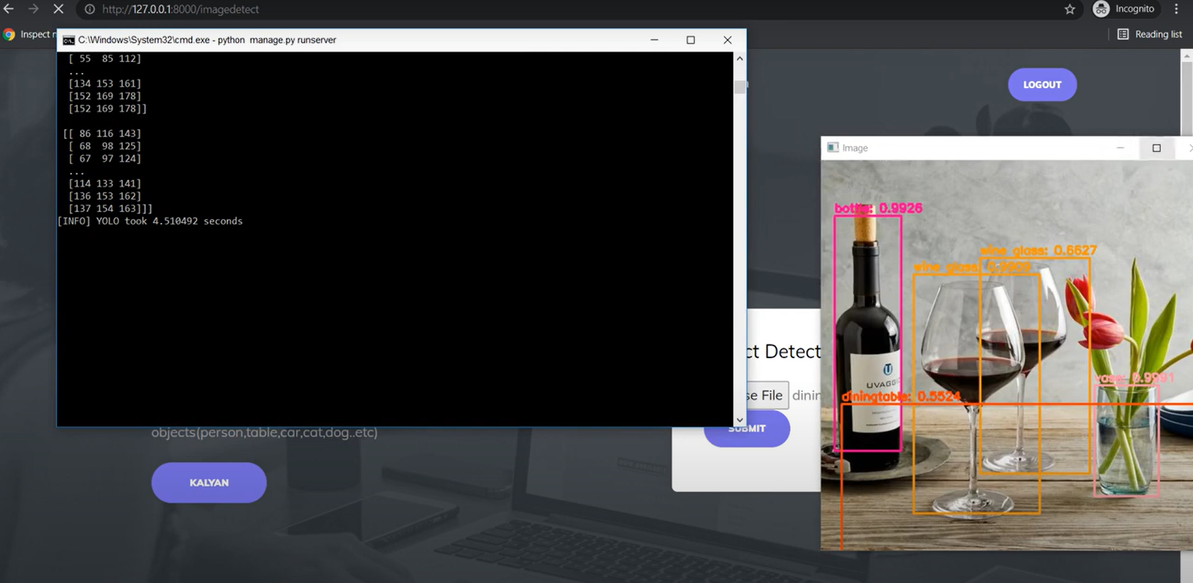
This image demonstrates the processing and analysis of uploaded files using the object detection system. On the left, a command-line interface displays bounding box coordinates for detected objects and logs information about the detection process, including the time taken to analyze the image. On the right, the visual output shows the detected objects (e.g., wine bottles, glasses, and flowers) outlined and labeled with their respective classifications and confidence scores. This interface provides users with both a textual and graphical representation of the detection results, ensuring clarity and accuracy in understanding the identified objects in the image.

Slide 28
REFERENCES
Kyoung Soon Hwang; Ki Sun Park; Sang Hyun Lee; Kwang Il Kim; Keon Myung Lee, “Autonomous Machine Learning Modeling using a Task Ontology” 2018 Joint 10th International Conference on Soft Computing and Intelligent Systems (SCIS) and 19th International Symposium on Advanced Intelligent Systems (ISIS)
Bekir Sahin; Anis Yazidi; Dumitru Roman; Ahmet Soylu,” Ontology-Based Fault Tree Analysis Algorithms in a Fuzzy Environment for Autonomous Ships”,2021 pp- 2169-3536
Li, D. “ Machines Learn Better with Better Data Ontology: Lessons from Philosophy of Induction and Machine Learning & Machines 33, 429–450 (2023).
Ghanadbashi, S., Golpayegani, Practice.”Minds F,”Using ontology to guide reinforcement learning agents in unseen situations”. Appl Intell 52, 1808–1824 (2022).
S. Kanjana, S. Maleerat, “Ontology Knowledge-Based Framework for Machine Learning Concept”, iiWAS '16 Proceedings of the 18th International Conference on Information Integration and Webbased Applications and Services, pp. 50-53.

Slide 29
Mitsuru, S. Kazuhisa, K. Osamu, M. Riichiro, “Task ontology: Ontology for building conceptual problem solving models”, In proceeding of ECAI98 Workshop on Applications of Ontologies and Problem-Solving model, pp.126-133, ECA.
V. Joaquin, S. Larisa, “Expose: An Ontology for Data Mining Experiments”, Third Generation Data Mining Workshop at ECML PKDD.
A. Martín, B. Paul Barha, C. Jianmin, C. Zhifeng, D. Andy, D. Jeffrey, et al., “TensorFlow: A System for Large-Scale Machine Learning," Operating Systems Design, and Implementation, Vol. 16, pp. 265-283, 2016.
Thomas R. Gruber, “ A Translation Approach to Portable Ontology Specifications” Knowledge System Laboratory, Technical Report KSL 92-71.
A. F. Martins, R. A. F. De, “Models for Representing Task Ontologies”, Proceeding of the 3rd Workshops on Ontologies and their Application.

Slide 30
Gustavo Correa Publio, Diego Esteves, Agnieszka Ławrynowicz, Panče Panov, Larisa Soldatova, Tommaso Soru, Joaquin Vanschoren, Hamid Zafar, “ ML Schema: Exposing the Semantics of Machine Learning with Schemas and Ontologies”.
Guarino, N., Oberle, D., Staab, S. (2009). What Is an Ontology? In: Staab, S., Studer, R. (eds) Handbook on Ontologies. International Handbooks on Information Systems. Springer, Berlin, Heidelberg.
Evgeny Kharlamov,Dag Hovland,Martin Georg Skjæveland,Dimitris Bilidas, “Ontology based data access in statoil”.
Y. Alfaifi, "Ontology Development Methodology: A Systematic Review and Case Study," 2022 2nd International Conference on Computing and Information Technology (ICCIT), Tabuk, Saudi Arabia, 2022, pp. 446-450, doi: 10.1109/ICCIT52419.2022.9711664.
A. Castro, V. A. Villagrá, P. García, D. Rivera and D. Toledo, "An Ontological-Based Model to Data Governance for Big Data," in IEEE Access, vol. 9, pp. 109943-109959, 2021, doi: 10.1109/ACCESS.2021.3101938

Slide 31
THANK YOU

